Slide 1

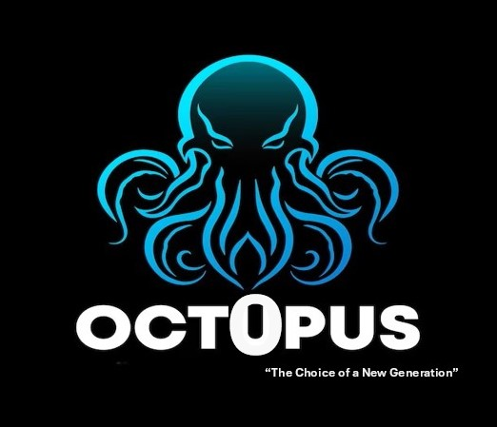
OCTOPUS A multinational corporation
Name: Haque A Nur Munna
Batch – 14
Dept. of Soil and Environmental Sciences
Date: 06/06/2024

Slide 2

About Us
Its main objective is to help reduce poverty and boost the agricultural sector in Bangladesh.
Octopus has been working towards this goal since 2022, particularly in developing the agricultural and rural areas of the country.
Octopus currently provides direct employment to around 2000 individuals and indirectly supports 100000.
Octopus is one of the most popular food and beverage company in Bangladesh..

Slide 3
Our Inception
Octopus
Our story began in 2022, in the hands of visionary Haque A Nur Munna. He saw an excellent business opportunity in Bangladesh’s optimal cultivating environment. This inspired him to create an epoch-making business to redefine the nation’s food manufacturing industry while serving society and its people. And that’s how Octopus was born.

Slide 4



OCTOPUS, The Choice of a new generation
Our Vision Improving Livelihood Our Mission Poverty & hunger are curses.
Mission & Vision
Octopus is the most versatile and diversified food & beverage Company in Bangladesh. Our dedication and contribution has helped us unlock numerous number of achievements.
Achievements
We take pride in our hard work and continuous efforts that made us become OCTOPUS— a name, a face, an organization of marvelous performance, leaving positive marks on the native.
Corporate Values

Slide 5


Octopus Group has more than 500 products and 5 Division.
Octopus Group
Food and beverage
Culinary Products
Dairy Products
Snacks
Confectionery

Slide 6
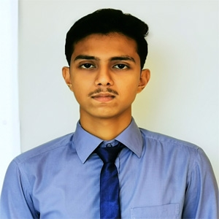
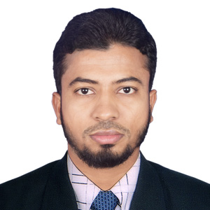
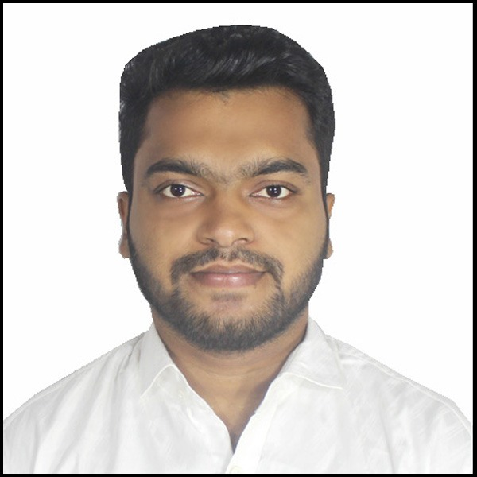
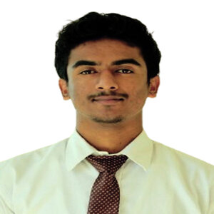

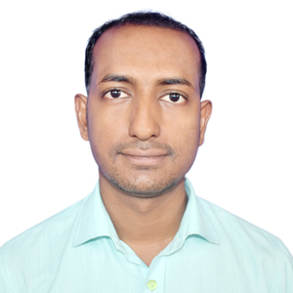
COMPANY TEAM SLIDE
M. Shahabuddin, Chief Human Resources Officer
Md. Rocky, Head of Marketing
Md. Ilias, Managing Director
Rasel Hossain, Associate Art Director
Haque A Nur Munna
Md. Rakib, Legal Officer
Shakil Khan, Founder Filmers
Chairman & CEO

Slide 7
Flow chart of food industry supply chain
Farm, Grower, Producer
Food Manufacturer, Bulk Shipper or Processor
Retail Distributer
Food service Distributer
International Shippers
Grocery Stores
Restaurants
International Markets
Customers and Consumers

Slide 8
Sales and Cost Statistics
Monthly Report - 2024
Month | Expenses | Sales | Retail Profit | Profit/ Loss
January | 7854500 | 8750000 | 895500 | Profit
February | 9998300 | 9920000 | -78300 | Loss
March | 8985700 | 10000000 | 1014300 | Profit
April | 8876550 | 8756000 | -120550 | Loss
May | 9988300 | 11200000 | 1211700 | Profit

Slide 9
Sales and Cost Statistics

Slide 10

Conclusion
OCTOPUS is a corporation that firmly believes in providing equal opportunity for everyone, and our talent management has ensured the perfect atmosphere for the workforce, enabling them to work together as a team.
Above all, as a company, OCTOPUS truly believes in dedicating itself for the benefit of its stakeholders and society at large.
Corporate Headquarters:
Octopus Center
3rd Baitul Aman Road, Rupatoli,
Barisal - 8200, Bangladesh.
Phone: +880-1631401055
Fax: +88-02-8867435
Factory: Pangsha, P.S: Biman Bondor,
Upazila: Babugonj, Barisal, Bangladesh.
Email: info@octopusconsumer.com
Social:

